Slide 1


2025 Landlord Refresher Course
Presented by the City of DeKalb – Crime Free Housing Bureau

Slide 2
Disclaimer
While some slides will address legal information in general, the Law deals with “specific facts” presented in each situation. The information presented here should not be relied upon as a substitute for legal advice.
Always consult an attorney.

Slide 3

A Note to Landlords:
Over the last two years, you, as landlords, and the Crime Free Housing Bureau have collaboratively worked together which has resulted in a decrease in Crime-Free nuisance notifications being issued due to unlawful activity being committed on rental properties. In 2023, there were 98 nuisance notifications issued by November 1st, and in 2024, there were 43 notifications as of November 1st.

Slide 4
A Note to Landlords Continued:
This is a decrease of 56% and is due mainly because of the shared responsibility and communication between all parties involved.
As responsible landlords, you guys have made a big difference.
THANK YOU!!!

Slide 5

NUISANCE PROPERTY
A nuisance property is defined as unlawful activity occurring on the rental property.

Slide 6
A reminder the following are not unlawful activities:
Contact made to the police or other emergency services, if: a) the contact was made with the intent to prevent or respond to domestic violence or sexual violence; b) the intervention of emergency assistance was needed to respond to or prevent domestic violence or sexual violence; or c) the contact was made by, on behalf of, or otherwise concerns an individual with a disability and the purpose of the contact was related to that individual’s disability.
An incident or incidents of actual or threatened domestic violence or sexual violence against a tenant, household member, or guest occurring in the rental unit or on the leased premises
Unlawful activity occurring in the rental unit or on the leased premises that is directly relating to domestic violence or sexual violence, engaged by the tenant, member of a tenant’s household, guest, or other party, and against a tenant, household member, guest or other party.

Slide 7
Unlawful activities/narcotics

Slide 8

In 2024, the DeKalb Police Department investigated and seized larger than normal amounts of narcotics from rental properties. The 2024 annual report/crime statistics are not completed at this time. However, over the last several years, the department has seen a significant increase in drug/narcotic/drug equipment violations throughout the City.

Slide 9
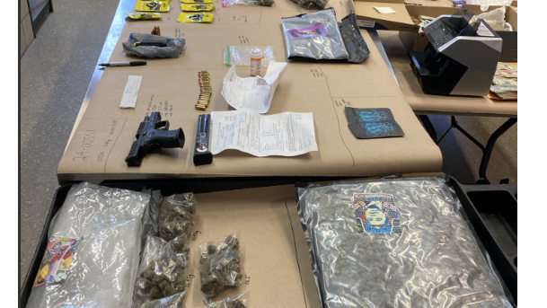
The photos contained in the following slides are drug seizures taken from rental units in the city of dekalb in 2024.

Slide 10
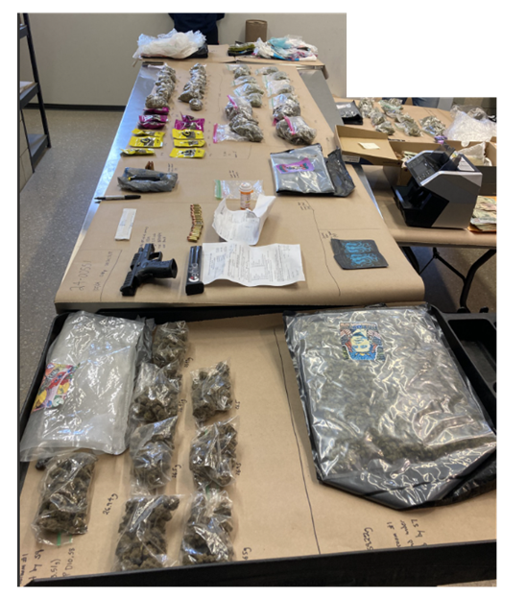
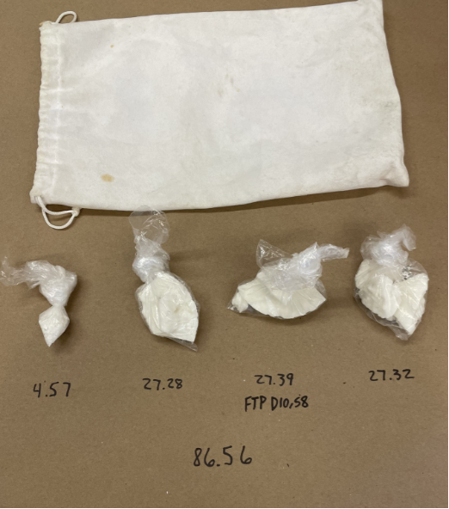
Cannibas, United States Currency (close to $80,000.00), and one illegal firearm seized from an apartment.
More than three ounces of Crack Cocaine seized from an apartment.

Slide 11
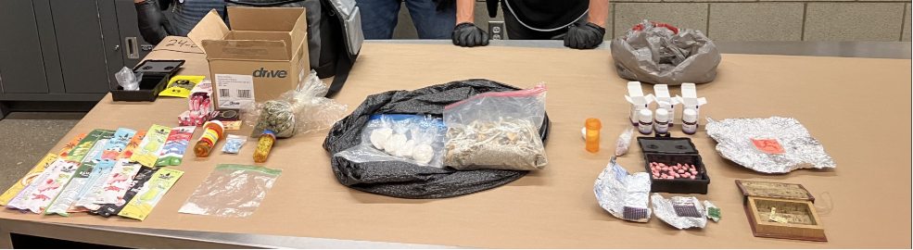
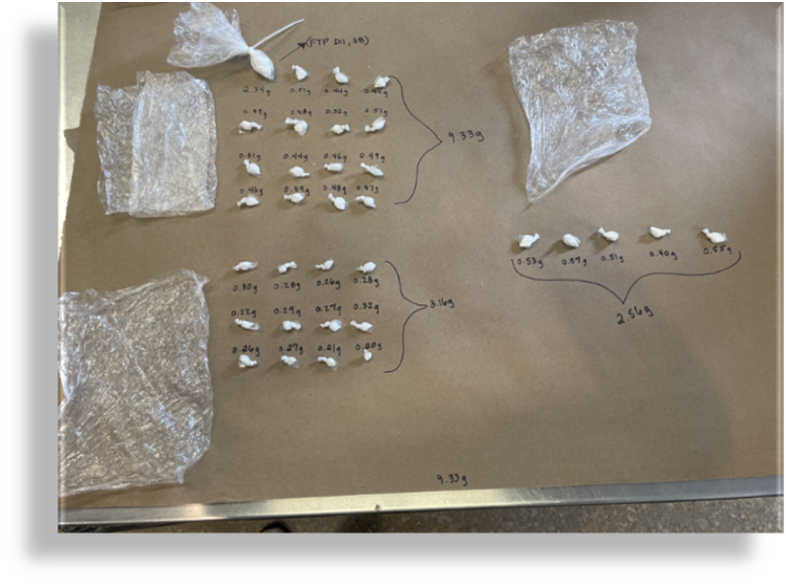
THC carts, Cannabis, Cocaine, Psilocyn Mushrooms, LSD, MDMA pills, and prescription pills seized from a crawl space on a rental property.
33 bags of Crack Cocaine seized from an individual as he left a rental property (living with tenant).

Slide 12
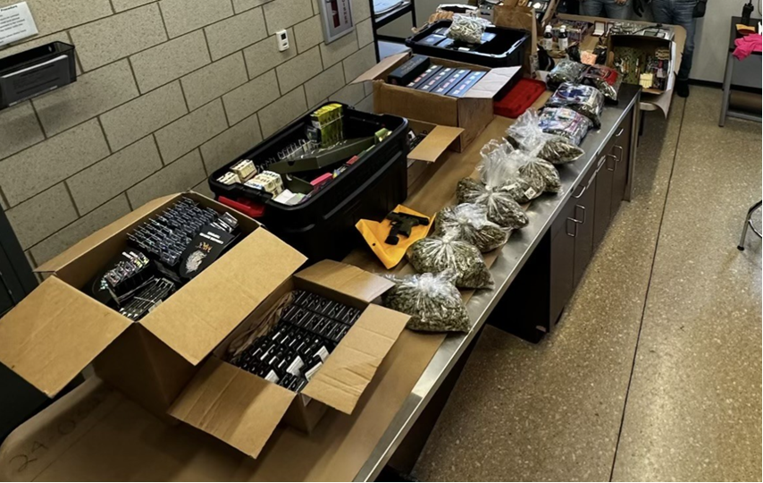
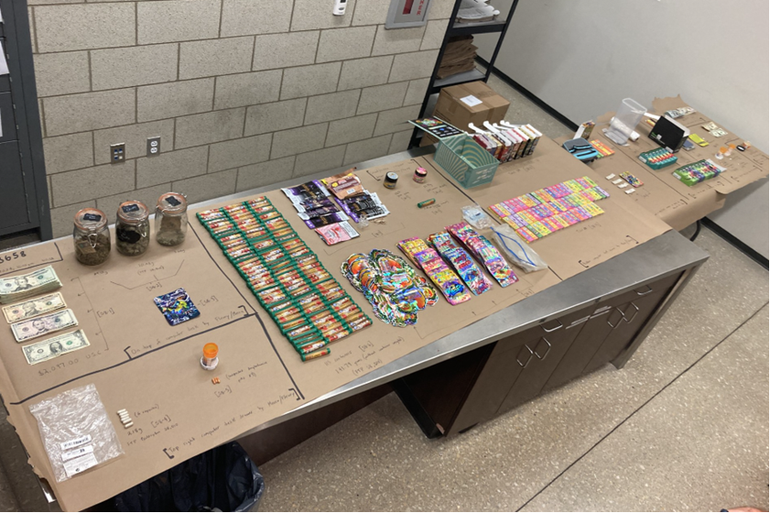
Cannabis, THC carts, US currency, and pressed Psilocyn Mushroom pills seized from an apartment.
THC carts, Cannabis, Methamphetamine pills, replica LSD, one firearm, US currency, jewelry, Psilocyn Mushrooms, Cocaine, pills, liquid narcotics, and other drugs seized from an apartment.

Slide 13
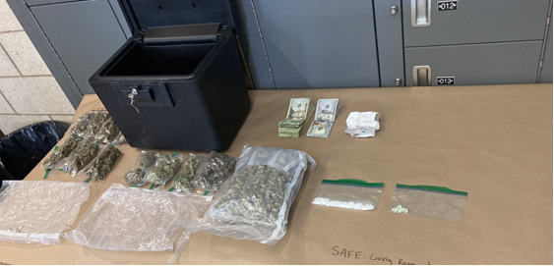
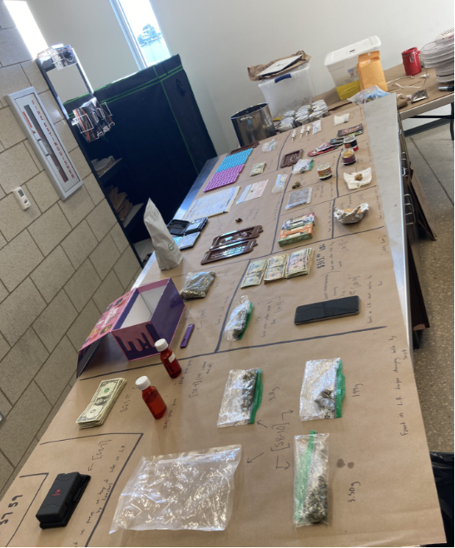
Cannibas, US currency, pills, LSD, Psilocybin Mushrooms, Psilocybin edibles, and a Psilocybin Mushroom grow seized from an apartment.

Slide 14
Illegal drug activity warning signs
Fortified entry and interior doors
People visiting all hours of the day for brief periods
No visible means of support, yet tends to pay rent in cash
Pays rent months in advance
Drug equipment – pipes, bongs, syringes, small baggies, etc.
Weight scales, large amounts of foil, baking soda, or other chemicals

Slide 15
Illegal activities that can be attributed to narcotic use:
Drug Possession
Disorderly House
Battery
Weapon Offenses
Aggravated Battery
Disorderly Subjects
Thefts/Home Invasions
Death
Drug Sales
Assaults
Overdoses
Murder

Slide 16

Ways to combat illegal activity​
Trespass Agreements with the DeKalb Police Department.
Hold tenants accountable to their lease provisions and the Crime Free Addendum.
Secure buildings.
Install proper lighting/motion lights.
Create clear site lines of the property (keep bushes and trees trimmed).
Install surveillance cameras.
Perform routine inspections.
Keep property clean of graffiti and trash.
Unlike other illegal activities, drug usage and sales are usually visible to those outside the home/residence. As landlords and neighbors, we need to stay engaged and address any and all illegal activity that arises. These crimes can have a big impact on the families involved and the neighborhoods in which they occur.
Do not ignore warning signs!

Slide 17

Be an engaged landlord
DeKalb Police Department:
Emergency – 911
Non-Emergency – 815-748-8400
Crime Free Housing – 815-748-2374
Look for signs of illegal activities occurring on your properties. Reach out to the DeKalb Police Department or the Crime Free Housing Bureau for assistance.

Slide 18

Make sure you treat everyone FAIRLY and ensure all tenants sign your lease and the Crime Free Housing Addendum

Slide 19
Project Hope
NEED HELP?
If you have a tenant that you believe may have an addiction and needs assistance, you can reach out to the Police Department for help.
The Police Department has a program called PROJECT HOPE. PROJECT HOPE (Heroin, Opioid Outreach Prevention and Education) has placed approximately 100 people into addiction treatment facilities.

Slide 20
Thank you
Thank you for taking this year’s refresher course. Please click here to register that you have completed this training.
Be well,
Bob Redel
Bob Redel
Assistant City Manager
815-748-2374

